Slide 1
Tips for Phase & Time Sync
A case study with Orange Egypt
Ahmed Medhat, Oscilloquartz
Sherif Fouad, Orange Egypt

Slide 2
Outline
Case study of a collaborative project between Orange Egypt and Oscilloquartz
Project objective: evolution of synchronization from TDM-frequency to PTP-phase
Evolution in phases
Constraints from the existing transport network and its evolution potential
Testing: can the performance objectives be met?
Comparison of PTP profiles for phase
Conclusions and future work

Slide 3





Initial situation: TDM sync network / frequency
GNSS
MSC
MGW
BITS Clk
Core Elements
Cesium
BSC/RNC
SSU
Cesium Based PRC System
MW Access Cloud
Orange Property
BITS Clk
Core Site
SDH Backbone Cloud
3rd Party
2G/3G TDM Site
GNSS
3rd party STM Clk
BITS Clk
MW Access Cloud
Orange Property
GNSS Receiver
BITS Clk
GNSS Based PRC System
BSC/RNC
2G/3G TDM Site
Remote BSC/RNC Sites

Slide 4

1st evolution: SyncE sync network / frequency
GNSS
SyncE ports
MSC
MGW
BITS Clk
Core Elements
Cesium
BSC/RNC
SSU
Cesium Based PRC System
MW Access Cloud
Orange Property
SyncE
SyncE
SyncE
Core Site
IP Backbone Cloud
3rd Party
2G/3G IP Site
3rd party STM Clk
GNSS
SyncE ports
SyncE
MW Access Cloud
Orange Property
SyncE
GNSS Receiver
BITS Clk
GNSS Based PRC System
BSC/RNC
2G/3G IP Site
Remote BSC/RNC Sites

Slide 5

2nd evolution: PTP sync network / frequency
GNSS
MSC
MGW
BITS Clk
Core Elements
Cesium
BSC/RNC
SSU
MW Access Cloud
Orange Property
Cesium Based PRC System
G.8265.1
G.8265.1
G.8265.1
Core Site
IP Backbone Cloud
3rd Party
G.8265.1
HDSL Cloud
3rd Property
G.8265.1
2G/3G/4G IP Site
G.8265.1
GNSS
G.8265.1 back up from Core GM
G.8265.1
2G/3G/4G Small Cell IP Site
G.8265.1
MW Access Cloud
Orange Property
G.8265.1
GNSS Receiver
BITS Clk
GNSS Based PRC System
BSC/RNC
2G/3G/4G IP Site
Remote BSC/RNC Sites

Slide 6
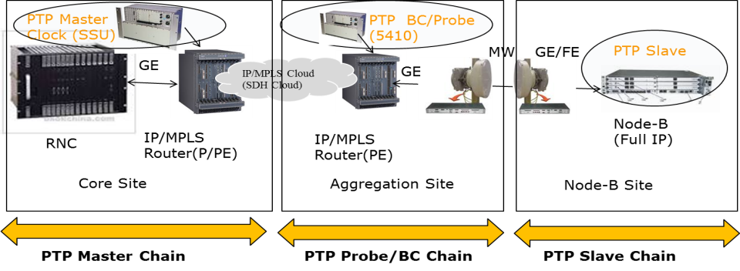
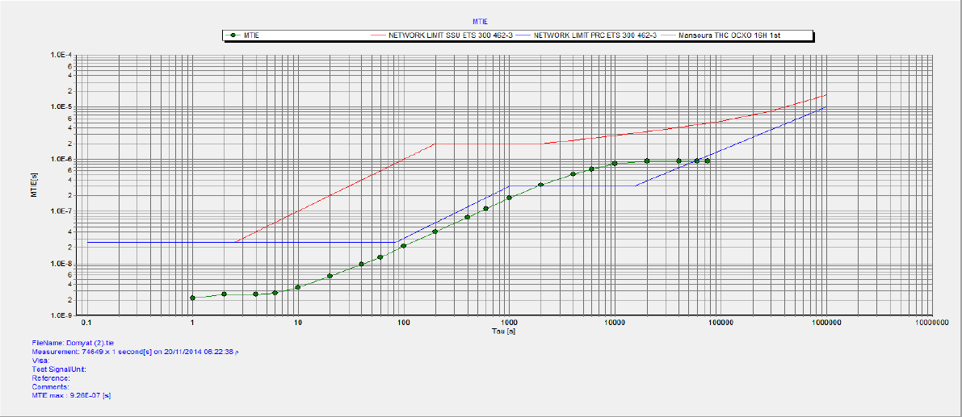
Test 1: Macro Node-B via MW link with G.8265.1
6 MW
PASSED

Slide 7
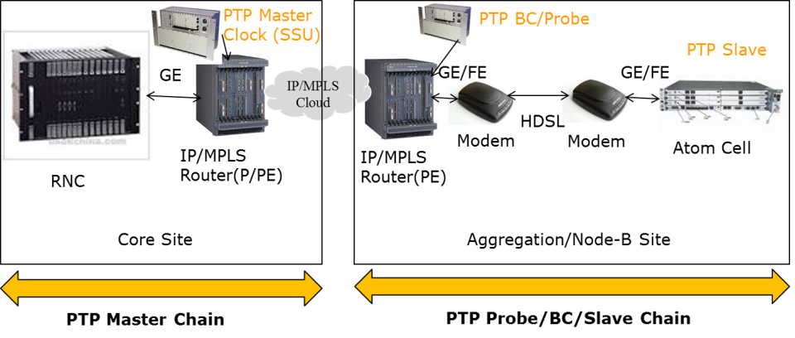
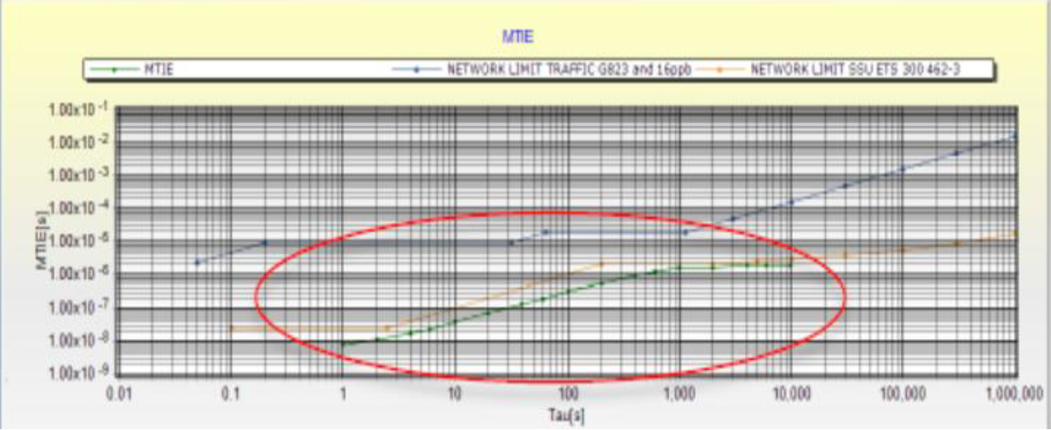
Test 2: Small Cell via HDSL link with G.8265.1
PASSED

Slide 8
3rd evolution: heading towards PTP phase sync
Intention to prepare the network infrastructure for phase synchronization in view of new LTE-A features such as Carrier Aggregation, COMP, eICIC
The following PTP options were considered:
  ITU-T G8275.1 (Full On Path Support)
  ITU-T G8275.2 (Partial On Path Support)
Limitations in Orange’s access network:
  MW vendor A: MW systems “A1” cannot be upgraded, systems “A2” can be upgraded (software, license)
  MW vendor B: existing “old” MW system cannot be upgraded to support BC; BC only with replacement by “new” MW systems
Partial on path support Profile ITU-T G8275.2 was our closest solution to be tested with above limitations

Slide 9

Test sequence 1: MW vendor “A” & G.8275.2
Router
G.8265.1 back up from closest Core GM
G.8265.1 & G.8275.2
GNSS
Slave/Probe
G.8265.1 & G.8275.2
G.8275.2
G.8275.2 (MW Only)
PTP APTS
MW Access Cloud
6 MW Hops
G.8265.1
GNSS Based PRTC System
BITS Clk
SADAT BSC
BSC/RNC
Bypass IP router to enhance margin
6OCT-WDY-NKL
Get closer when TE> 1.1 us

Slide 10
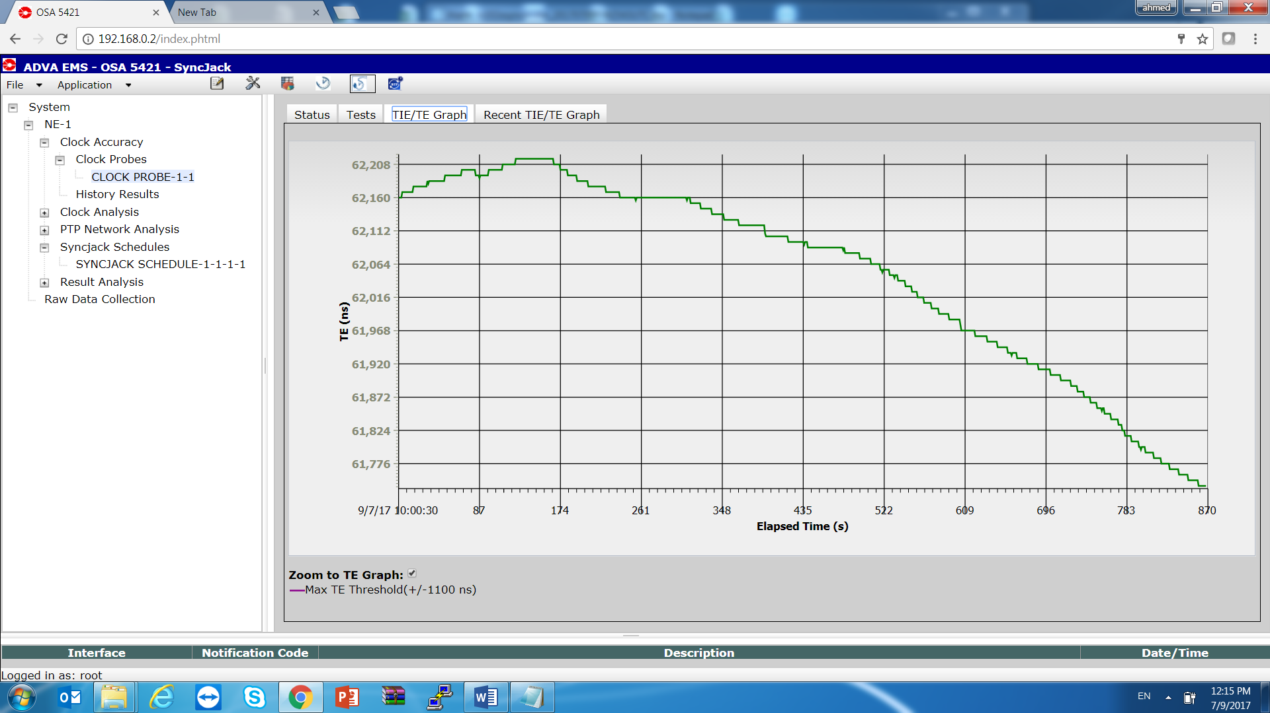
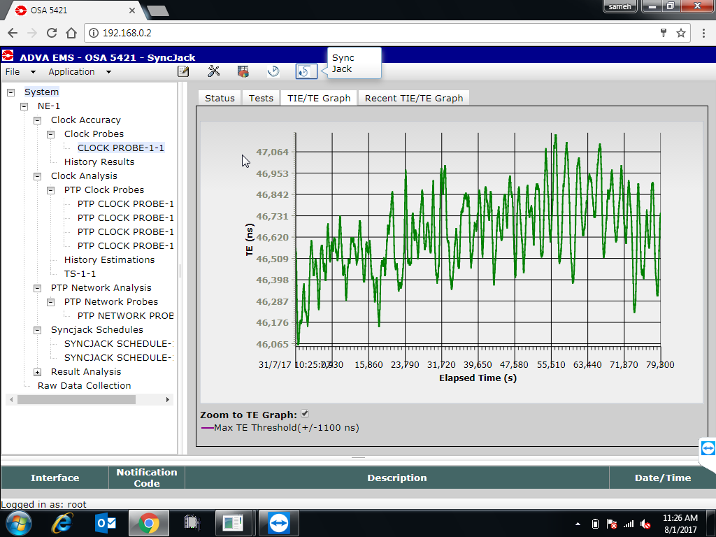
Results test sequence 1 (vendor “A”)
FAILED
FAILED
TE collected over 6 MW links + 1 Router
TE collected over 2 MW links + 1 Router

Slide 11
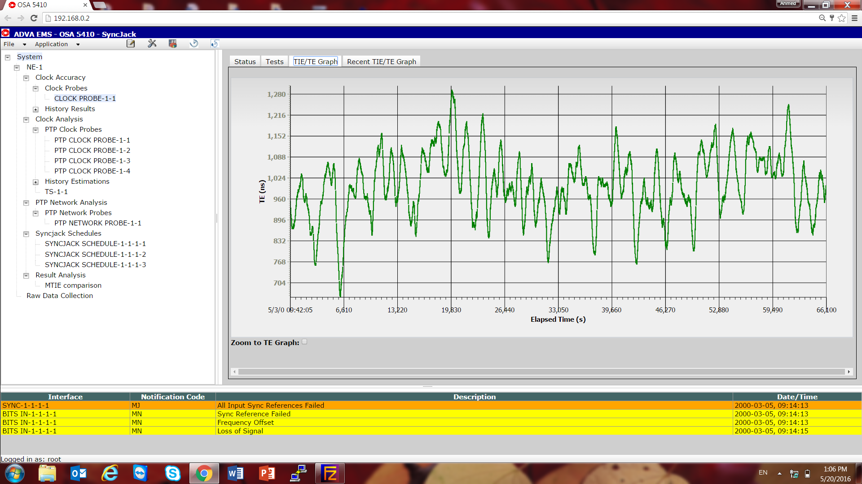
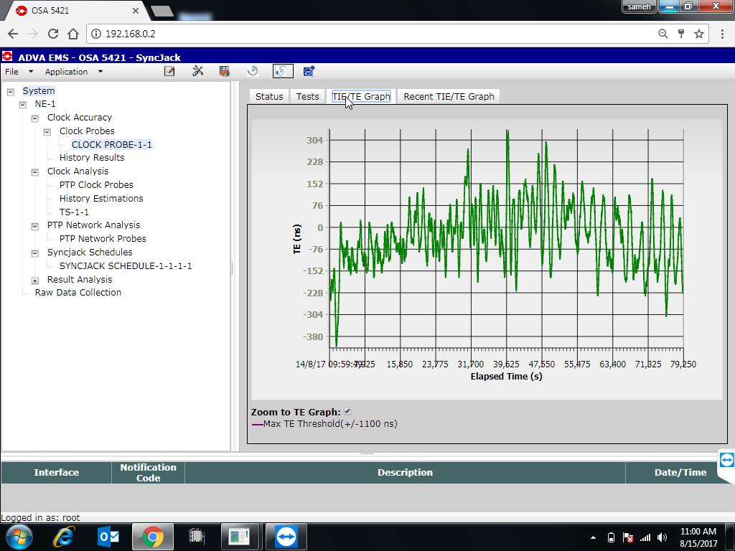
Results test sequence 1 (vendor “A”) Cont.
FAILED
PASSED
TE collected over 3 MW (Bypassing Router)
TE collected over 2 MW links (Bypassing Router)

Slide 12
Test sequence 2: MW vendor “B” & G.8275.2
Router
GNSS
G.8265.1 Back up from closest Core GM
G.8265.1 & G.8275.2
G.8265.1 & G.8275.2
Slave/Probe
G.8275.2
G.8275.2
PTP APTS
MW Access Cloud
7 MW Hops
G.8265.1
GNSS Based PRTC System
BITS Clk
Amerya BSC
BSC/RNC
Bypass IP router to enhance margin
NBRYA-WST-1
Get closer when TE> 1.1 us

Slide 13
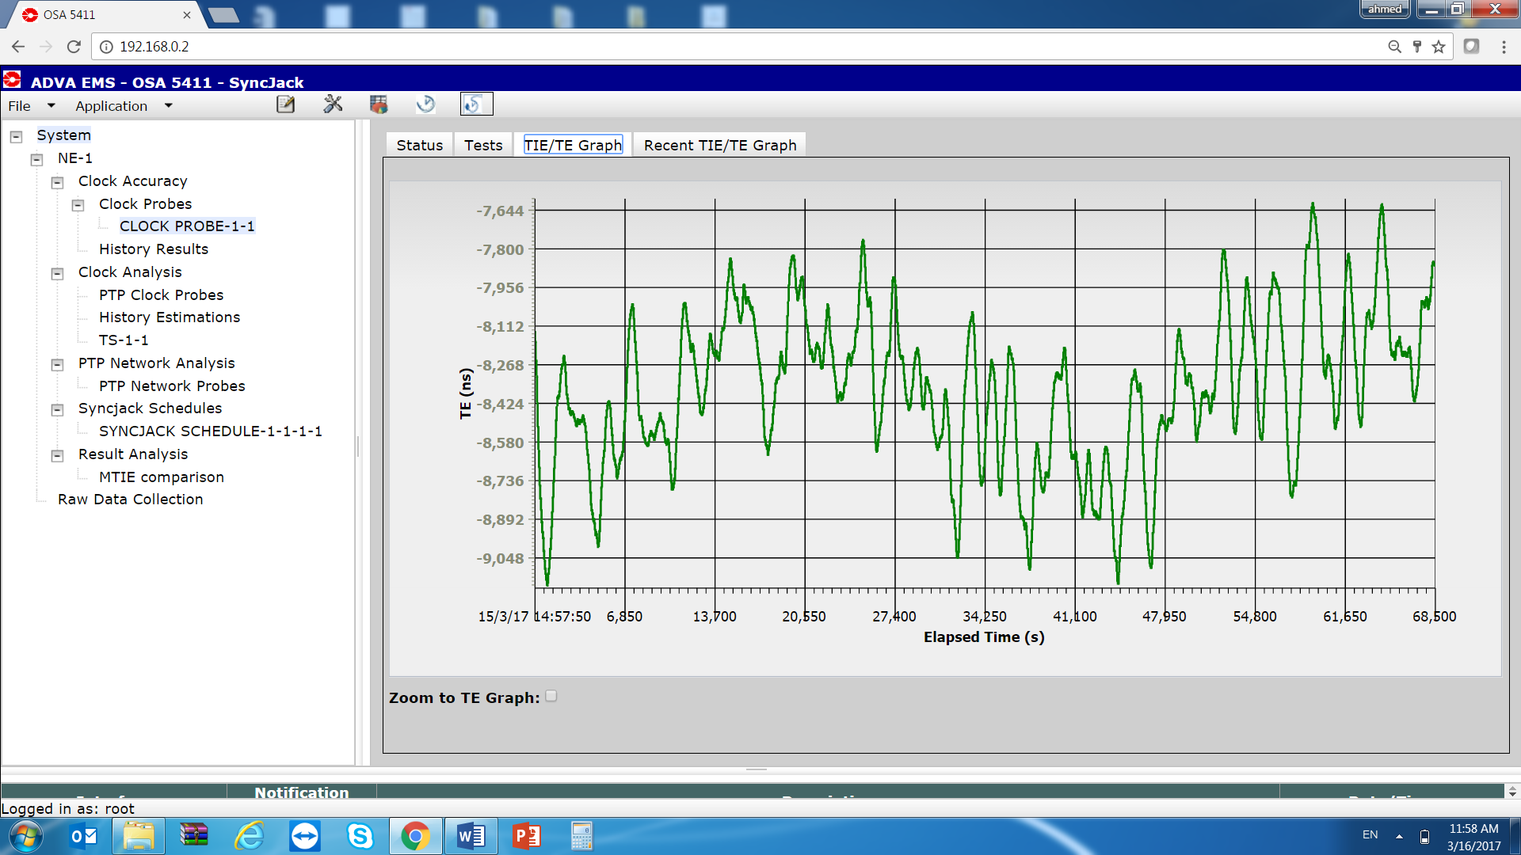
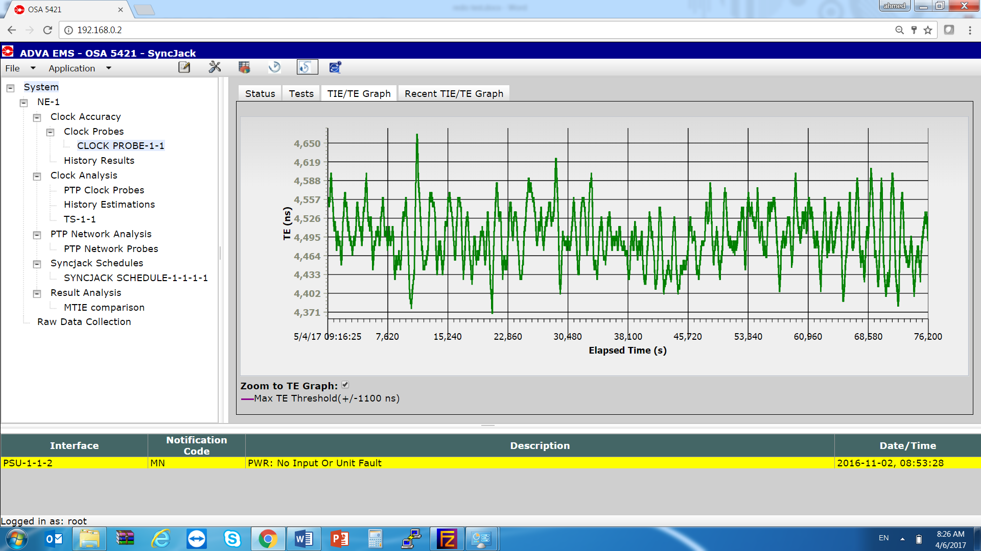
Results test sequence 2 (vendor “B”)
FAILED
FAILED
TE collected over 5 MW links (Bypassing Router)
TE collected over 2 MW links (Bypassing Router)

Slide 14
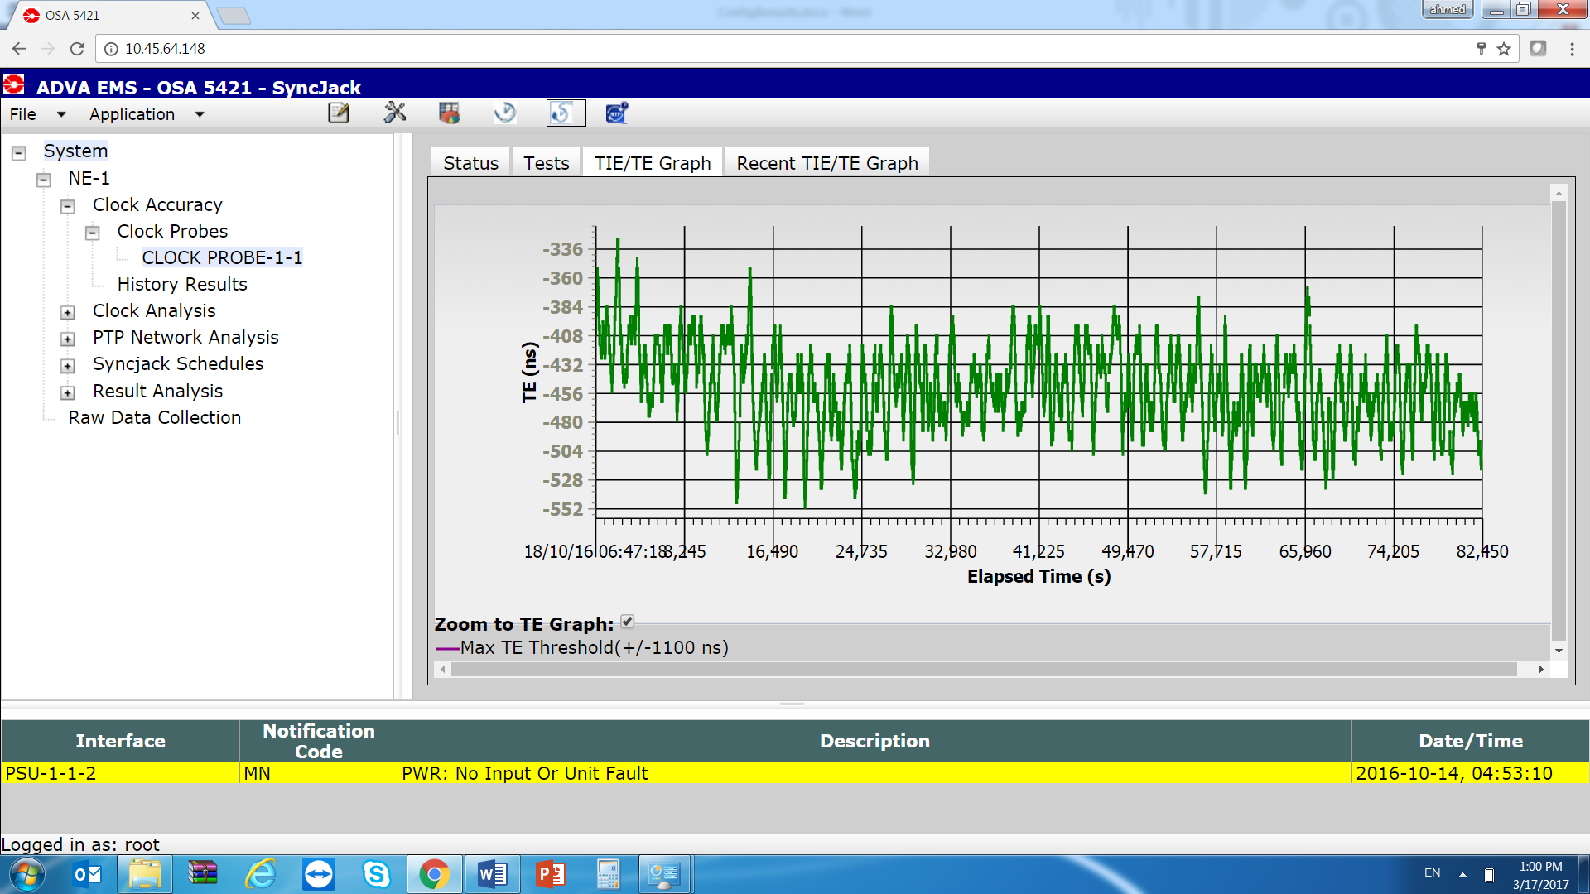
Results test sequence 2 (vendor “B”) Cont.
PASSED
TE collected over 1 MW link (Bypassing Router)

Slide 15
Phase POC summary and way forward
G8275.2 PTP profile can be used over maximum 1 (vendor B) or 2 (vendor A) MW hops
Enabling G8275.1 BC is the only way to deliver phase over longer MW chains
MW vendor A:
  Upgrade all “A2” MW systems for BC support
  Replace all “A1” MW systems (not upgradeable) with new A2 systems with BC Support
MW vendor B
  Replace the “old” MW systems (not upgradeable) with the “new” systems with BC Support
  OSA to Propose “Intermediate” cost effective Solution to enable phase delivery on hybrid chains until completing the full MW swap to “new” MW system
Schedule further tests to prove G.8275.1 performance

Slide 16
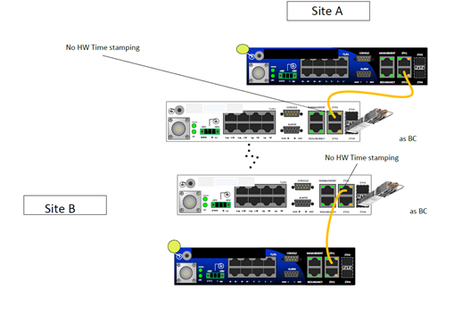
3rd evolution option 1: SFP Sync Plug@ “old” MW Vendor “
“New”
PTP G8275.1
“”old””
PTP G8275.2
“”old””
“New”
This scenario is not recommended as the PTP will encounter asymmetry on the old MW links

Slide 17
3rd evolution option 2: SFP Sync Plug @ “new” MW links
PTP G8275.1
PTP G8275.2
PTP G8275.1
This scenario recommended as the PTP will not encounter asymmetry

Slide 18
Conclusions
Extensive performance testing was necessary to verify PTP Frequency/Phase whether existing network infrastructure is able to transport synchronization with the required performance
G.8275.2 PTP profile proved inadequate in microwave access network
G.8275.1 in the access network is the way to go in this case
Further tests with G.8275.1 are under way

